Slide 1
1.5 Design Thinking
By: Minal Bombatkar

Slide 2
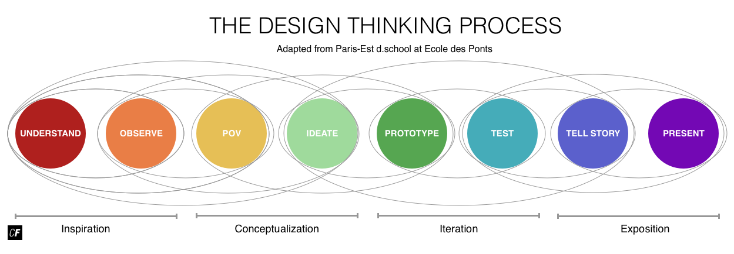
Design Thinking Process: “Yoga expert” app
Adapted from Paris-Est d.school at Ecole des Ponts

Slide 3
INSPIRATION
UNDERSTAND:
It is first important step to understand how make the app around a specific target audience and it’s scope should be narrow. So that, it will be straight to understand the need and problem of the target audience. As for “Yoga Expert” app the audience will be women and very specific in sense, women those who are going through nine months pregnancy process or post pregnancy process. Once clear to understand the need and requirement of the target users. In order to solve a problem, need to understand a problem first. After that perform competitor analyses.
OBSERVE:
In this second stage of the Design Thinking Process, I will be performing user research in order to observe potential users and determine their needs and goals. User interviews and surveys help to complete this process.

Slide 4
CONCEPTUALIZATION
POINT OF VIEW (POV):
For the project, I will consider all women who come under the age group of 19 years to 40 years for user personas. It will be important to understand the needs of a variety of people, interest and potential goals. This will create greater chance of fulfilling users needs efficiently.
IDEATE:
Up till now I will able to collect all these observations, it’s time to make ideas out of them. This is the part of the creative process that allows me to explore a wide variety and large quantity of diverse possible solutions. User flows and card sorts help to flow of the design and organised the menus.

Slide 5
ITERATION
PROTOTYPE:
This is the experimental stage of the process. It’s time to transform ideas into a physical format. I will build the paper wireframe after many such paper wireframe, then turn them into interactive prototypes using tools such as Invision or Figma. The app must be visually appealing and effective when put into use.
TEST: Testing prototypes with real users, help for collecting feedback, then improving and iterating designs again and again. Allowing users to test the prototypes, will help me focus on particular pros and cons in the app based off of user feedback. It will be important to focus on structure and design during this stage. Which will make the app successful.

Slide 6
EXPOSITION
TELL A STORY: In this stage, need to combine all from personas to problem statement and solutions to it, combine into one presentation. By telling story, help to understand the scope and limitations of the applications. Shows them if persona will use this app how benefit them in terms of performance. At this stage, while still being open to critique and feedback.
PRESENT:
As UX designer my goal at this point will to communicate what developers should code based on blueprints and design is ready to be handed off to developers for further development and full production.

